Slide 1
Catalogue of French 17th c. manuscripts
Simon Gabay
(UniNe)

Slide 2
Project
FNS Project
  3 years (currently in the 3rd year…), and maybe slightly more
  Université de Neuchâtel and Université de Lausanne
  International collaborations (CNRS-ATILF)
  Looking for funding to finance phase II of the project

Slide 3
Idea
A French problem: no editorial protocol for French 17th c. text
  Mainly an hermeneutical approach of the text
  No philological approach=No raw documentation for a linguistic study

Slide 4
Documentation
A test case: Madame de Sévigné (1626-†1696), known for her letters to her daughter, Madame de Grignan
Expand to other 17th authors

Slide 5
Method
Step 1: Find the sources
  Autograph manuscripts
  Manuscript and printed copies
  Facsimiles
  Pictures

Slide 6
Method
Step 2: Transcribe and publish online
  Catalogue
  Transcription (edition?) of the documents in the catalogue

Slide 7
Method
Step 3: build annexes
  Linguistic study
  Indexes
  Glossary

Slide 8
Method
Step 4: connect the results
  Physical (Bibliothèque Nationale de France) and digital (www.biblissima.fr) libraries for manuscripts
  Französisches Etymologisches Wörterbuch (FEW) for lexical data

Slide 9
((very) optimistic) plan
Build a portal that
  catalogues manuscript documentation
  provides (basic) linguistic data
  Allows us to share easily the results

Slide 10
Glossary: sources
Available lexicographic (re)sources
  No scientific dictionary of 17th French
  Many 17th and (especially) early 18th works
  Dictionnaire de la langue française of Emile Littré (?)

Slide 11
Glossary: goal
The goal is to propose
  A definition
  A synchronic and diachonic contextualisation of the word
  A discussion of the spelling

Slide 12
Glossary: goal
The goal is to propose
  A definition
  A synchronic and diachonic contextualisation of the word
  A discussion of the spelling
Ancient vs Modern

Slide 13
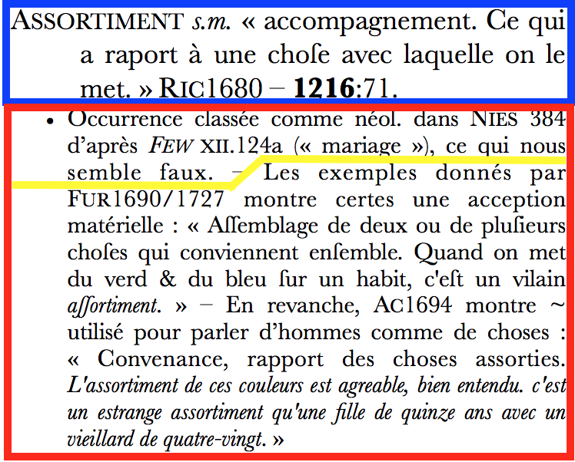
Glossary: draft

Slide 14
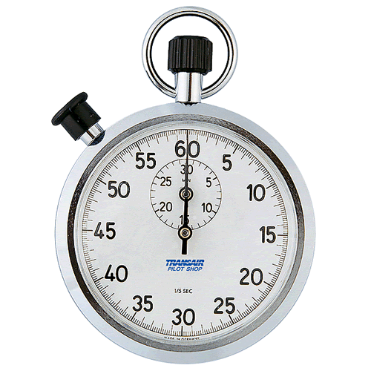
Time’s Up!
About your speaker:
  Name: Simon Gabay
  Institution: Université de Neuchâtel
  Social Media: nothing (yet)
  Quick bio: MA (Paris IV/St Andrews), PhD (Amsterdam), Habilitation… coming soon!

